Slide 1

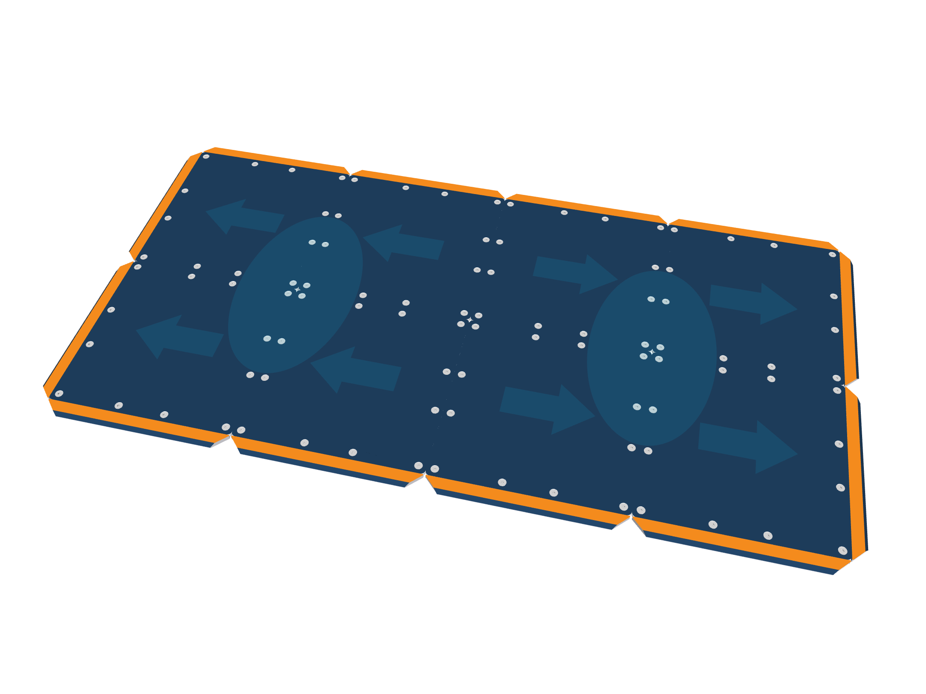
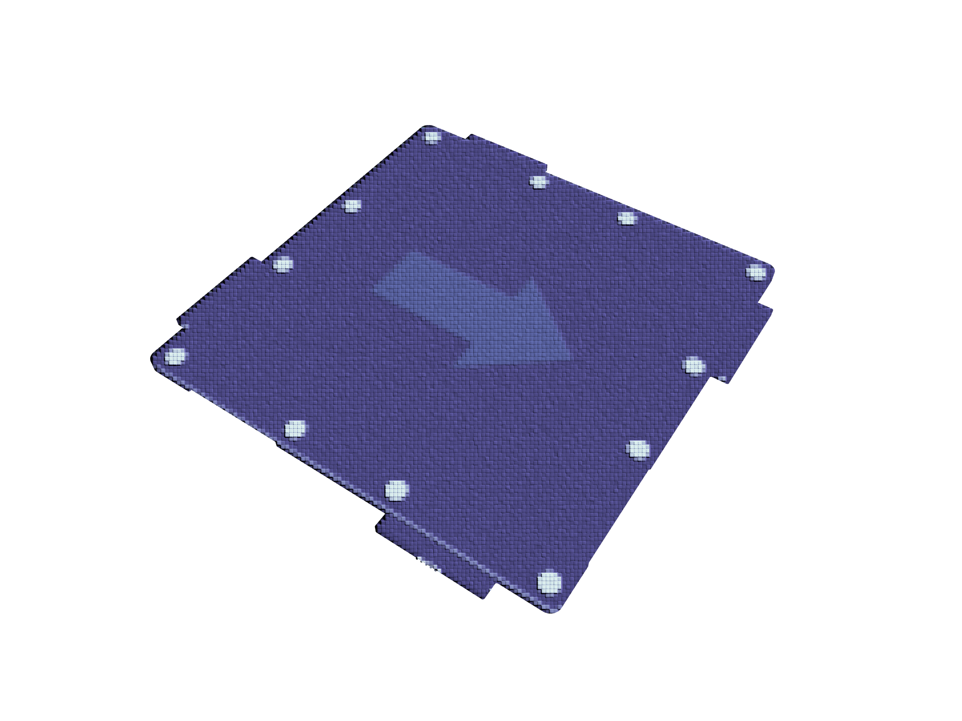
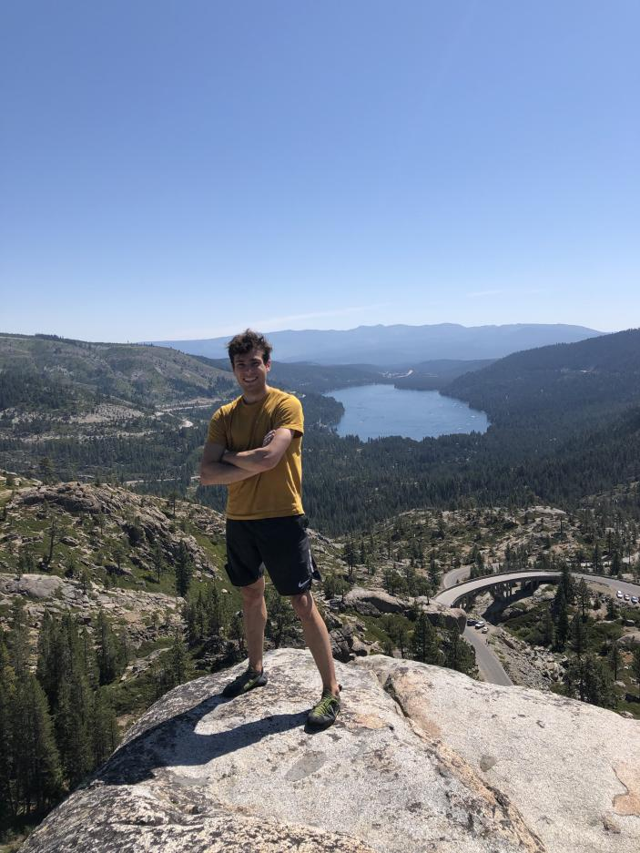

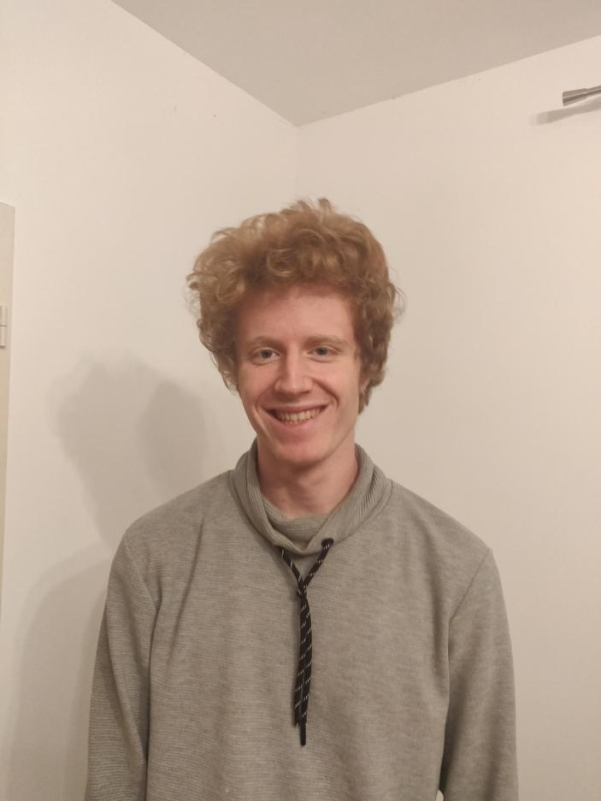
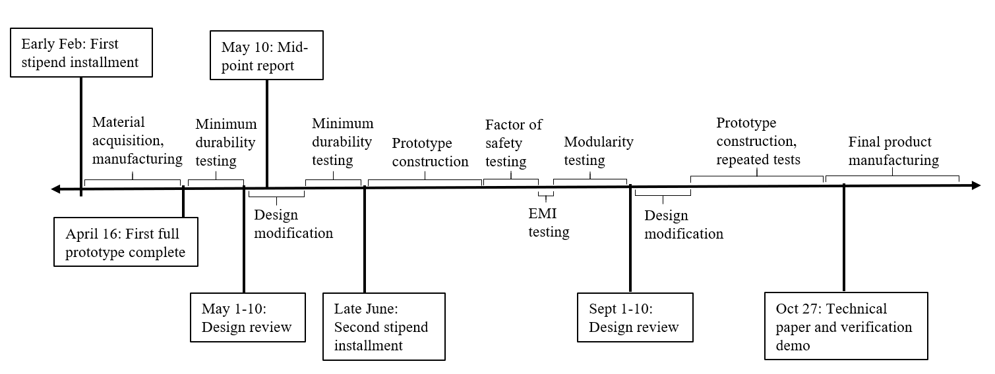


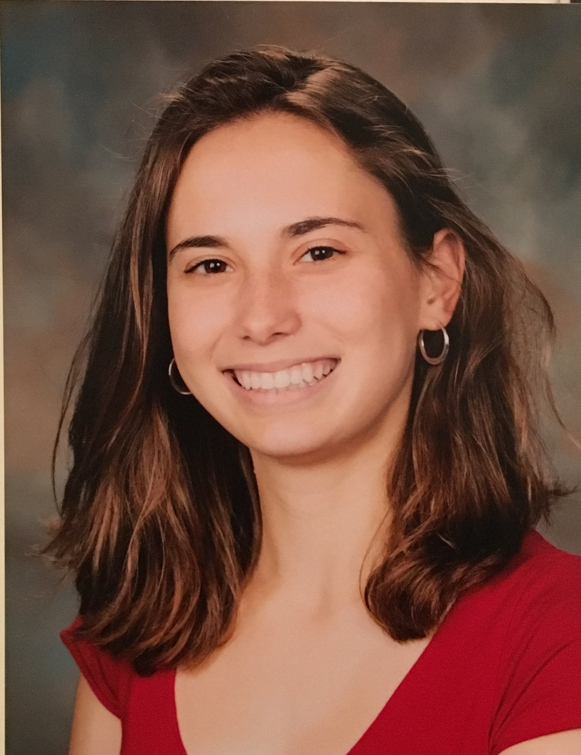
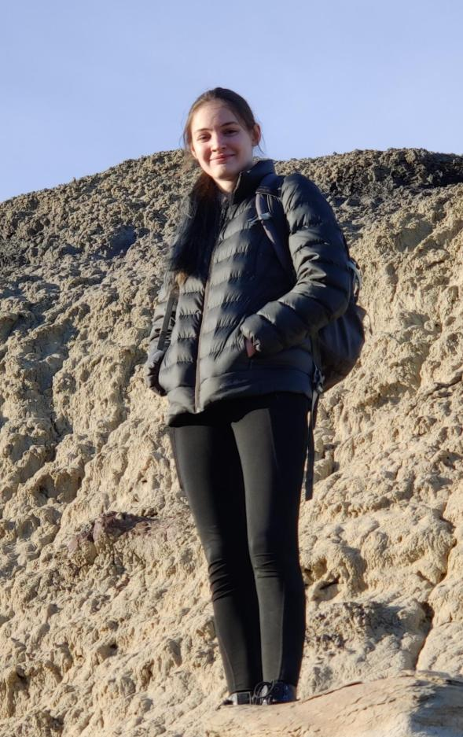
HOMES
Habitat Orientable & Modular Electrodynamic Shield
Objectives
Approach
Orientation specific direction of electric field
Dimensions:
25 cm x 25 cm x 6.5 mm
Attracts and transports lunar dust to reduce ingress into habitat
Effective at mitigating dust particle sizes of 0.5 to 100 µm
Clears 90% of lunar dust in 60 secs
HOMES is portable, durable, modular, low SWaPs device
Modularity allows for flexible solutions necessary for long term lunar use
Develop and validate to TRL 6
Leverages Electrodynamic Dust Shielding technology, TRL 7+
Three-phased AC square wave charges electrodes, generating a traveling electric field
Coulombic and dielectrophoretic forces transport dust on and above HOMES
Rotational symmetry and joints allow for tiling of HOMES in varying orientations
Largest, most compact, and durable known implementation of electrodynamic shielding technology
Mass Estimate: < 1.1 kg
Power Estimate: 25 W max
Rotationally symmetric finger joints with POGO pins for power distribution
Team
Key Milestones
7 States
3 Countries
8 Freshmen
2 Sophomores
4 Juniors
Dr. Soon-Jo Chung, Faculty Advisor
Malcolm Tisdale, ’22, Project Lead
Isabella Dula, ’22, Mechatronics Lead
Jules Pénot, ’24, Treasurer
Polina Verkhovodova, ’22, Mechanical Lead
Leah Soldner, ’24, Mechanical Lead
Calle Junker, ’23, Mission Integration Lead
Agile project management with twice weekly scrums
Caltech AIAA Student Branch project
Category | Subtotal | Subtotal including IDC
Travel | $16,980.00 | $20,376.00
Materials | $14,557.83 | $17,469.39
Machining | $3,175.00 | $3,810.00
Labor | $23,625.00 | $28,350.00
Testing | $20,000.00 | $24,000.00
Unforeseen | $5,000.00 | $6,000.00
Cost
Total without IDC: | $83,337.83
Total with IDC: | $100,005.39
First Phase: | $46,002.48
Second Phase: | $54,002.91
Notes:
*Note: the NASA logo may be replaced by a university or project logo

